Slide 1
GLOBAL ELECTRONICS
Retail Analysis in the Electronics Industry to improve the sales performance and efficient inventory management.
NAGABHARATHI GR

Slide 2
The Company
Global Electronics, a leading retailer of consumer electronics, has provided with several datasets containing information about their customers, products, sales, stores, and currency exchange rates.
The company seeks to leverage this data to better understand their business and identify areas for improvement.

Slide 3
The Problem
As part of Global Electronics' data analytics team, I have tasked with conducting a comprehensive Exploratory Data Analysis (EDA) to uncover valuable insights from the company’s data.
The goal is to provide actionable recommendations that can enhance customer satisfaction, optimize operations, and drive overall business growth.

Slide 4
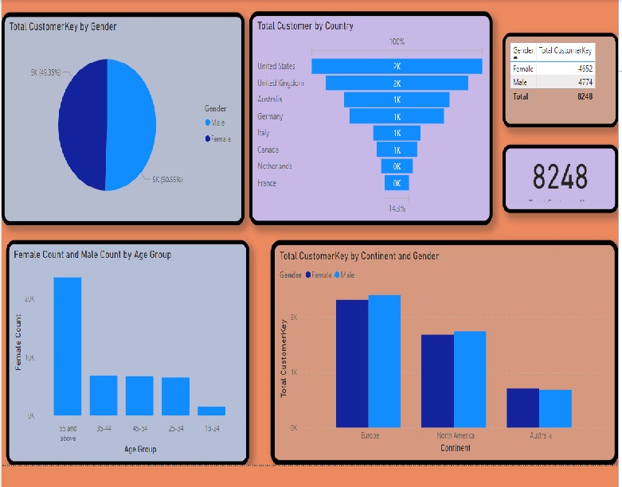
CUSTOMER ANALYSIS

Slide 5
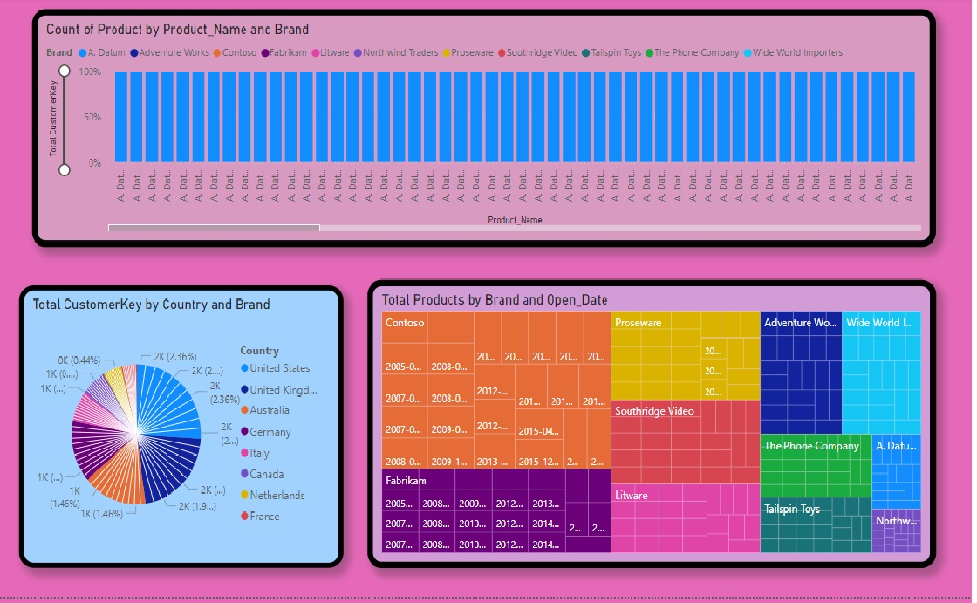
PRODUCT ANALYSIS

Slide 6
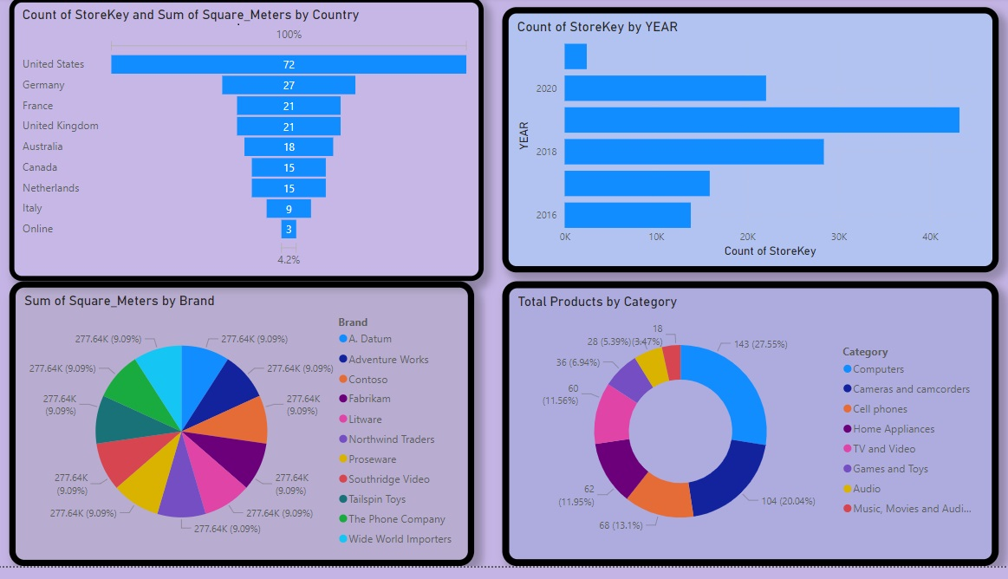
STORE ANALYSIS
The product with high profit margin is washers & dryers and then refrigerators. But they are the 3rd least selling category(Home Appliances).

Slide 7
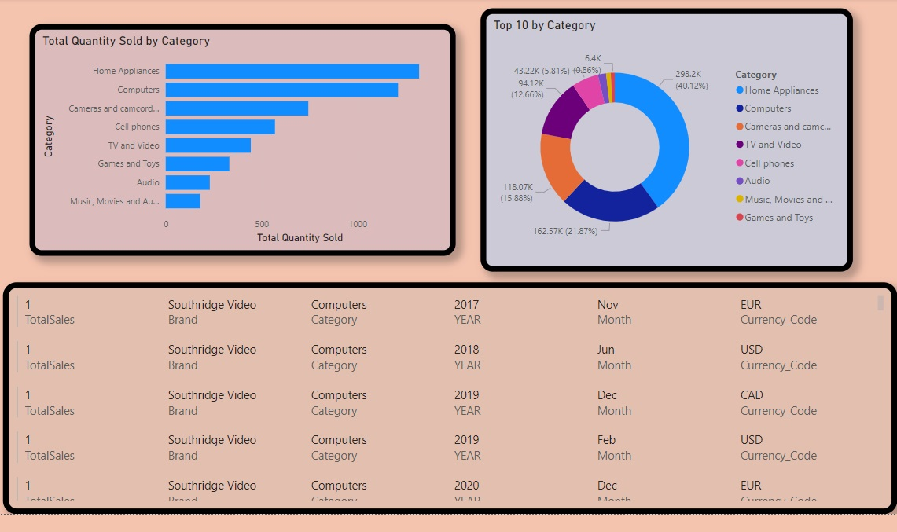
SALES ANALYSIS
Most selling categories are computers, cellphones and Movies and in computers, desktops are top selling and in cellphones, touch screens are top selling and in movies, movie DVD are top selling.

Slide 8
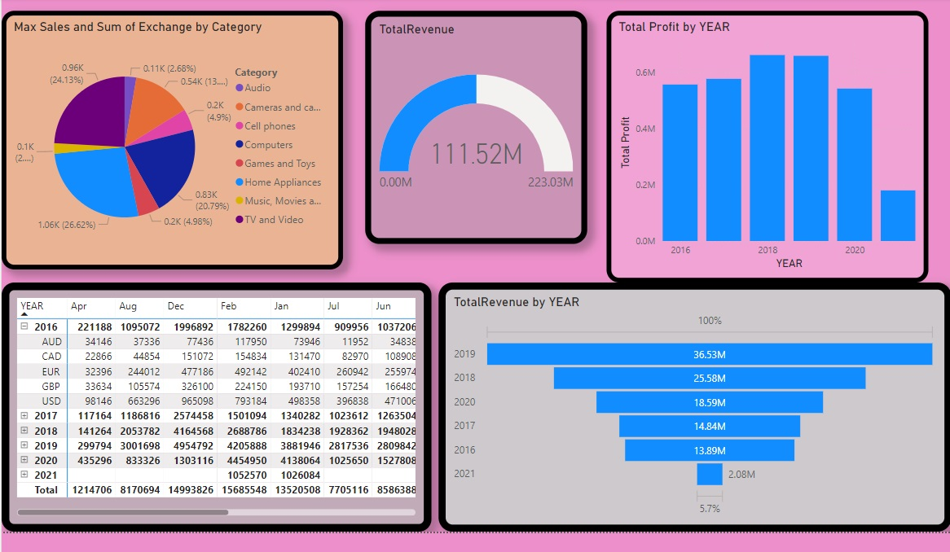

Slide 9
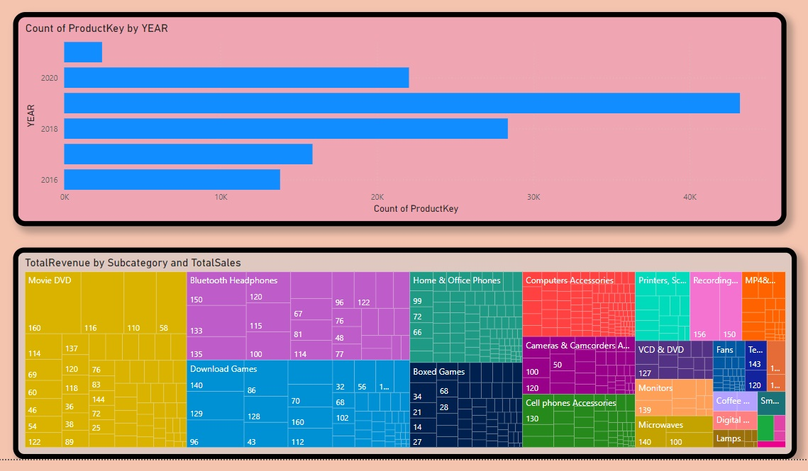

Slide 10
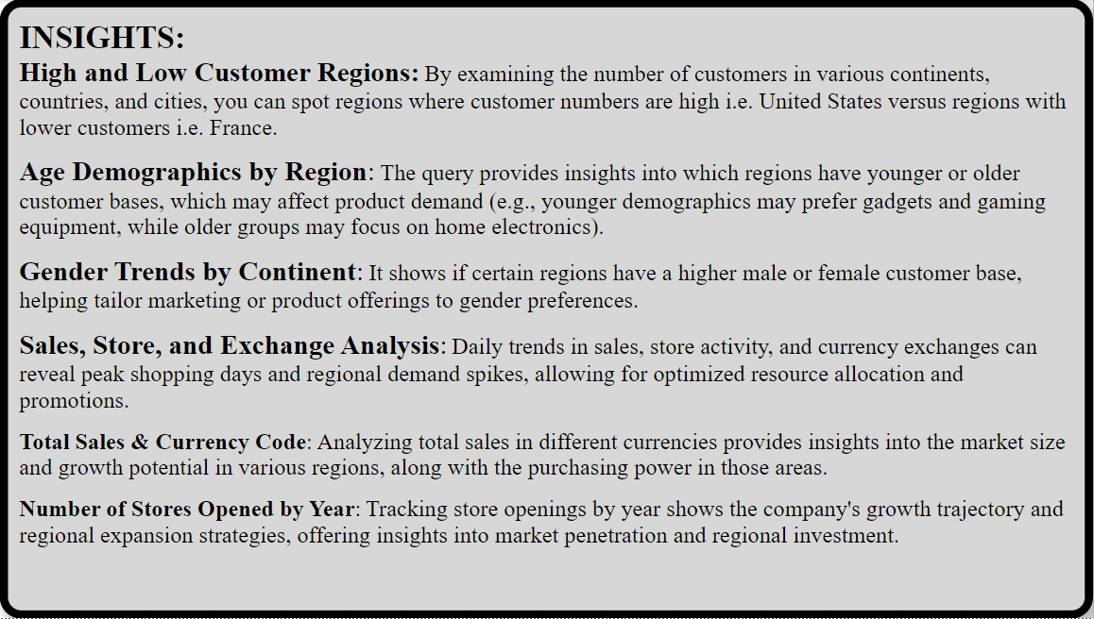

Slide 11
Thank You

